Slide 1
Veins and lymphatics
By Dr S Homathy

Slide 2
Disorders of veins
Varicose vein
Phlebothrombosis
Thrombophlebitis

Slide 3
Varicose vein
Abnormally dilated, tortuous veins
Produced by prolonged increase in intraluminal pressure and loss of vessel wall support

Slide 4
Types and sites
Superficial veins of the upper and lower leg
Prolonged standing leads to
Increased venous pressure
venous stasis
Pedal oedema
Females> males
Obesity increases the risk.
Pregnancy
Oesophageal varices
Haemorrhoids

Slide 5
Clinical features
Home work

Slide 6
Phlebothrombosis and Thrombophlebitis
Deep leg veins acccount of > 90% of cases.
What is Phlebothrombosis (DVT)?
What is Thrombophlebitis ?
What are the predisposing factors / causes of DVT?
Migratory thrombophlebitis?

Slide 7
Superior and inferior vena caval syndrome
SVS
Caused by
Neoplasm compress or invade the SVC
Bronchogenic carcinoma / mediastinal lymphoma
Clinical features
Marked dilation of veins of head, neck and arms
Cyanosis
Respiratory distress due to pulmonary vessel compression

Slide 8
IVS
Caused by
Neoplasm compress / invade the vessel (hepatocellular, renal cell carcinoma)
Thrombus from hepatic, renal, lower extremities
Clinical features
Lower extremity oedema
Distension of superficial collateral vein of the lower abdomen
Massive proteinuria in case of renal vein involvement

Slide 9
Lymphangitis and lymphoedema
Causes and consequences?
Home work

Slide 10
Tumours
Benign- haemangioma
Intermediate lesion
Highly malignant – angiosarcoma

Slide 11
Haemangiomas
Very common
Characterized by increased numbers of normal or abnormal vessels filled with blood
Commonly present at birth
Most are expand with growth
Many capillary lesion regress with time

Slide 12
Clinical variant of Haemangiomas
Capillary haemangioma
Most common variant
Occurs in the
skin,
subcutaneous tissues
mucous membranes of the oral cavities and lips
Liver
Spleen
kidneys.

Slide 13
Morphology
Gross
Bright reed to blue
Few mm to several cm in dm
At the level with surface / slightly elevated
Have intact overlying epithelium
Histology
Unencapsulated, aggregates of closely packed, thin – walled capillaries
Usually blood filed and lined by flattened epithelium
Vessels are separated by scant cT stroma
Lumen partioally or completely thrombosed and organised

Slide 14
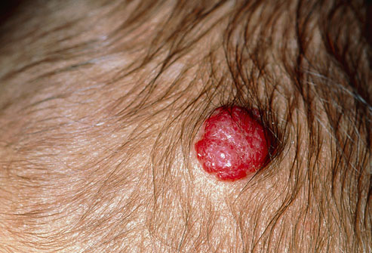
Strawberry Hemangiomas

Slide 15
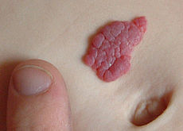

Slide 17
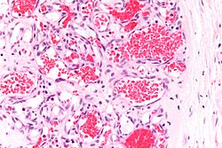

Slide 18
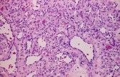

Slide 19
Cavernous haemangioma
Characterised by large, dilated channels
Less well circumscribed
Frequently involve deep structures.

Slide 20
Morphology
Gross
Red- blue, soft, spongy masses
Histology
Sharply defined, unencapsulated
Composed of large, cavernous blood - filled vascular spaces separated by a mild to moderate amount of CT stroma
Intravascular thrombosis with associated dystrophic calcification is common

Slide 21
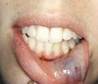

Slide 22
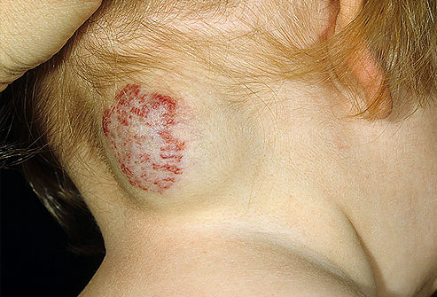
Similar to strawberry hemangiomas but are more deeply situated.
They may appear as a red-blue spongy mass of tissue filled with blood

Slide 23
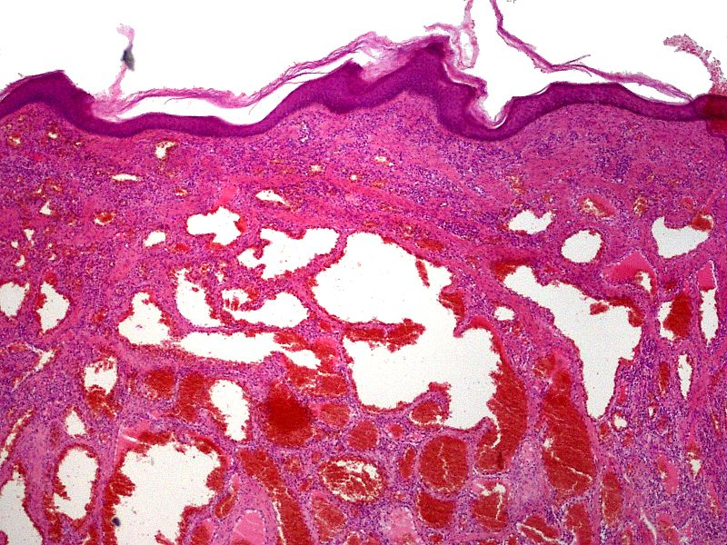
Cavernous hemangioma of the skin. H&E stain.

Slide 24
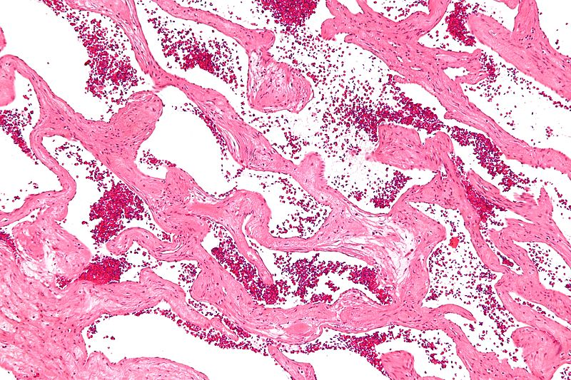
Cavernous liver hemangioma

Slide 25
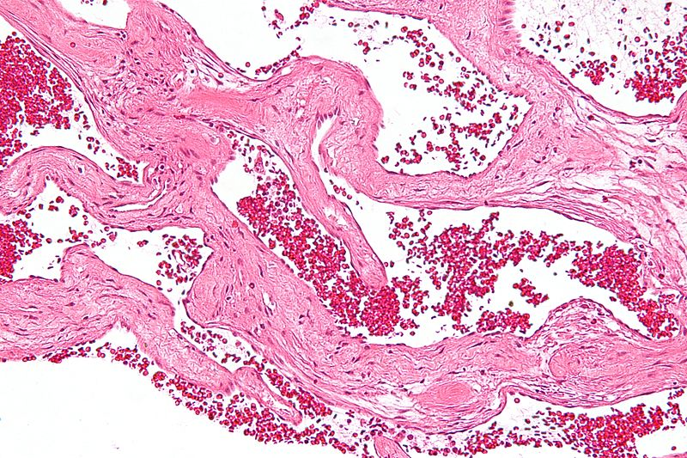

Slide 26
Pyogenic granuloma
Is a capillary haemangioma
Rapidly growing peduncular red nodule
Seen on the skin, gingival or oral mucosa
Bleed easily often ulcerated
Histology
Proliferating capillaries
Accompanied by extensive oedema
Acute and chronic inflammatory infiltrate

