Slide 1
Vaculitis
By Dr S. Homathy

Slide 2
Vasculitis
A group of Inflammatory disorders of the blood vessels that causes structural damage to the affected vessels including,
Thickening and weakening of the vessel wall,
narrowing of its lumen and
usually vascular necrosis.
Occurs in diverse clinical settings

Slide 3
Vessels of any type in virtually any organ can be affected.
Most commonly affect all small vessels from arterioles to capillaries to venules.

Slide 4
Mechanism
Immune mediated inflammation
Direct invasion of vascular walls by infectious pathogens
Other causes include
Physical and chemical injury
Irradiation, mechanical trauma, and toxins
Can be
Primary
Secondary to underlying disorders

Slide 5
Pathogenesis of noninfectioue vasculitis
Immune complex mediated
Immune reactants and complement can be detected in the serum or vessels
Ag –Ab complexes are deposited in vessel wall
Eg: drug hypersensitivity (penicillin)

Slide 6
2. Antineutrophil cytoplasmic antibodies (ANCAs)
Heterogenous group of Ab directed against enzymes found in cytoplasm of neutrophils, monocytes, EC
3. Antiendothelial cell Ab
Eg SLE, Kawasaki disease

Slide 7
Classification of Vasculitis
Based on pathogenesis
Based on type and size of vessel

Slide 8
Based on size of the vessels

Slide 9
Clinical manifestations
Depending on the vascular bed involved manifestation can be vary
specific to particular organ or tissue
Other common manifestations are
Fever
myelgia
Arthralgia
malaise

Slide 10
Laboratory investigation
Lab test | Interperetation
Routine test-FBC,LFT,RFT | Evaluate for haematologic,renal, and other organ involvment
Blood culture | Rule out infection
ESR | High value suggests inflammatory disease
CRP | High value- inflammatory
Rh factor | Rh arthritis

Slide 11
complements | Low value –increased consumption seen in SLE, cryoglobinaemia
cryoglobulins | Cryoglobulinaemia
ANCA | Wegwnous granulomatosis
CK | Elevatiom- myositis
Antinuclear Ab | SLE

Slide 12
Arteriography
Helpful in identifying and charaterising a vasculitis of large and medium sized arteries
PAN
Takayasu’s arteritis
Giant cell arteritis with an aortic arch syndrome

Slide 13
Giant cell arteritis / Temporal arteritis
Most common of the vasculitides
It is an acute and chronic vasculitis of large to small size vessels
It may be generalized
Often a chronic granulomatous inflammation

Slide 14
Most prominently involves the cranial branches of the arteries originating from the aortic arch (head and neck)
Specially temporal arteries
Also vertibral, opthalmic arteries and aorta (giant-cell aortitis)
Same disease spectrum as polymyalgia rheumatica
Mainly women 65-80 years old

Slide 15
The findings of 3 of the 5 criteria was associated with >90% of Pt who have diagnosed as GCA
Age > 50 years at time of disease onset
Localized headache of new onset
Tendeness or decreased pulse of the temporal artery
ESR > 50mm/h
Biopsy reveals a necrotising arteritis with predominance of mononuclear cells or a granulomatoys process with MN giant cells

Slide 16
Pathogenesis
T- cell mediated immune response to an unknown vessel wall antigen.

Slide 17
Presentation
Symptoms either
Only vague and constitutional without localizing signs and symptoms
Fever, fatigue, wt loss
Localizing symptoms
Facial pain / headache
Most serious are ocular symptoms associated with involvement of the ophthalmic artery
Appear quite abruptly in about half of Pts and range from diplopia to transient or permanent vision loss

Slide 18
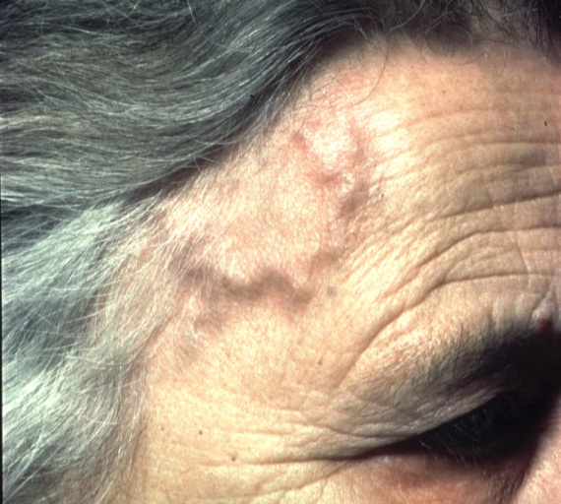
Presentation
Headache
Scalp tenderness
Thickened temporal arteries
Jaw claudication
Acute visual loss
Weight loss, anorexia, fever, night sweats, malaise & depression

Slide 19
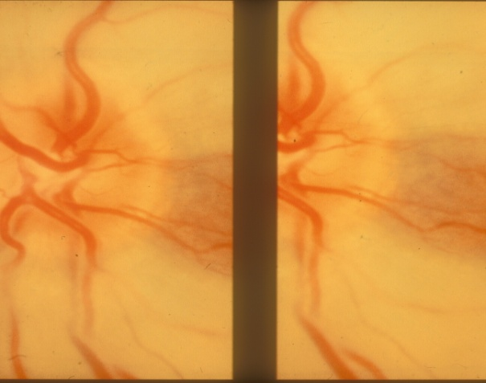
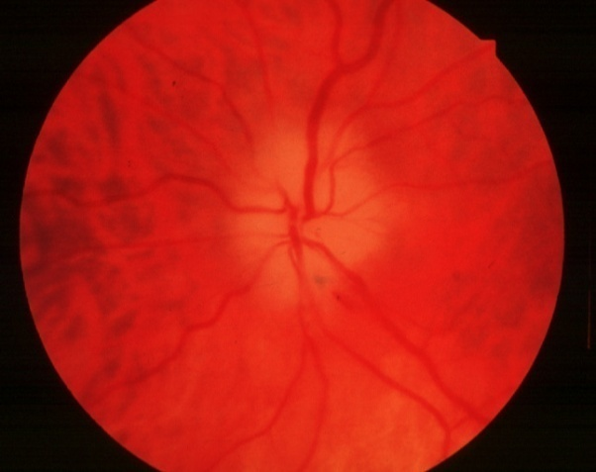
Ocular Complications
Transient monocular visual loss (amaurosis fugax)
Visual loss due to
Central retinal artery occlusion (CRAO) or
Anterior ischaemic optic neuropathy (AION)
Visual field defects

Slide 20
Morphology
Involvement is extremely segmental
Characteristically , segments of affected arteries develop nodular thickening with reduction of the lumen.
Arteries may become thrombosed

Slide 22
In the more common variant / classical lesion
Granulomatous inflammation of the inner half of the media centered on the internal elastic membrane marked by
MP and lymphocytic infiltrate,
multinucleate giant cells and
fragmentation of internal elastic lamina
MP are frequently seen in close proximity to the damaged elastic lamina.

Slide 23
In the less common variant
Granulomas and giant cells are rare or absent
There is a nonspecific panarteritis with mixed inflammatory infiltrate composed largely of
L, MP admixed with N and E
Later,
healed stage of both patterns reveals
collagenous thickening of the vessel wall
Organization of the luminal thrombus transforms the artery into a fibrous cord.

Slide 24
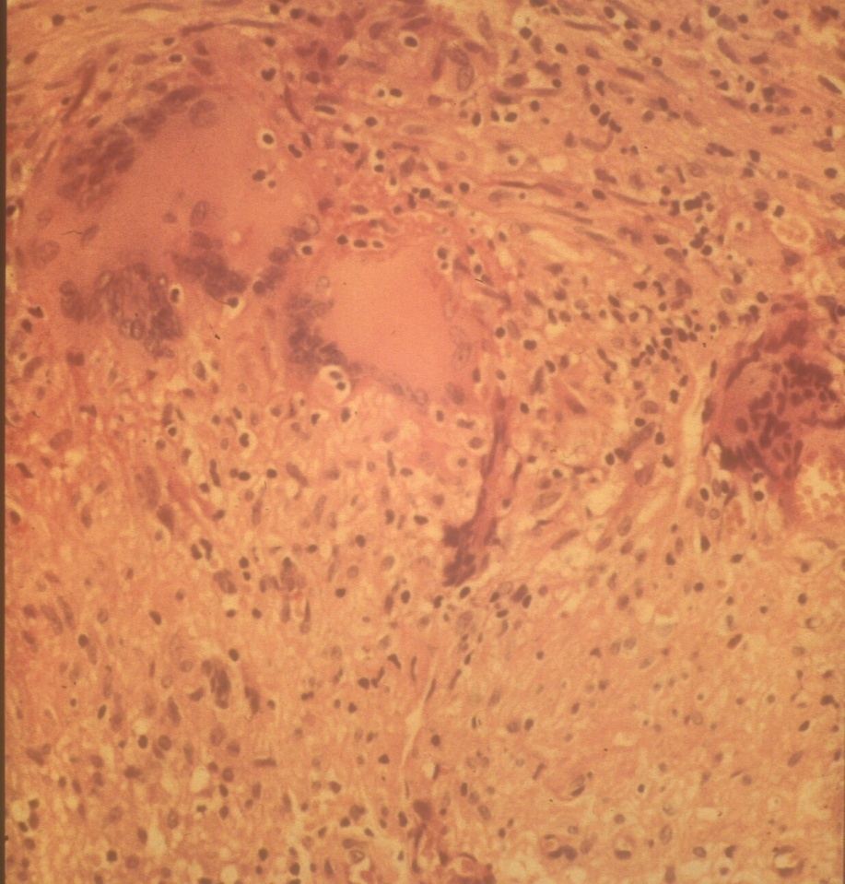
Granulomatous cell infiltration
Giant cells
Disruption of internal elastic lamina
Proliferation of intima
Occlusion of lumen

Slide 26
Diagnosis
Depends on biopsy and histologic confirmation
adequate biopsy requires at least a 2-3 cm length of the artery-
segmental nature of the involvement

Slide 27
Arteries have skip lesions
ultrasound/Doppler may help identify involved areas
If positive,
confirms diagnosis – helpful in management of future disease
If negative,
doesn’t exclude diagnosis, but need to think about an alternative diagnosis

Slide 28
Treatment
Start high dose steroids immediately to prevent stroke or second eye involvement
Intravenous and oral steroids – prolonged course of steroids often necessary
Temporal artery biopsy within a week of starting steroids

Slide 29
Takayasu arteritis
Garnulomatous vasculitis of medium and larger arteries
It affects the aorta and its branches.
Inflammation may be localized to a portion of the thoracic or abdominal aorta and branches or may involve the entire vessel.

Slide 30
Characterized principally by ocular disturbances and marked weakening of the pulses in the upper extremities (pulseless disease).
Fibrous thickening of the aorta and its branches.

Slide 31
Diagnostic clues ( 3 of the 6 criteria would be positive)
Age at onset < 40 years ( predominantly in females)
Claudications of extremities
Decrease pulsation of one or both brachial arteries
Difference of at least 10mmHg in sys BP between the arms
Bruit over one or both subclavian arteries or the abdominal aorta
Angiographic narrowing or occlution of entire aorta

Slide 32
Morphology
Classically involves the aortic arch
1/3 affect the remainder of the aorta.pulmonary involvement in half of the patient
Intimal hyperplasia and Irregular thickening of the aortic or branch vessels wall with intimal wrinkling
Narrow /Obliterate the orifices of the great vessels.
Renal and coronary vessels may be similarly affected

Slide 33
Histologically
Range from
An adventitial mononuclear infiltrate with perivascular cuffing of the vasa vasorum
To intense mononuclear inflammation in the media
To, granulomatous inflammation replete with giant cells and patchy necrosis of the media.
Some cases indistinguishable from temporal arteritis

Slide 34
Later, collagenous fibrosis involving all lagers of the vessel wall, particularly the intima.
Accompanied by lymphocytic infiltration
Involvement of the
root of the aorta may cause dilation
Producing AV insufficiency
Coronary Ostia may lead to MI.

Slide 35
Distinction among active giant cell lesions of the aorta are based largely on
Age of the patient

Slide 36
Clinical features
Initially –nonspecific
Later- reduced BP and weaker pulses in the upper extremities relative to the lower extremities.
Occular disturbances
Neurological deficit
Pulmonary HT
Systemic Ht due to renal artery involvment
MI

Slide 37
Polyarteritis nodsa
PAN is a systemic necrotising vasculitis that typically affects the small and medium sized muscular arteries
Not affect arterioles /capillaries / venules
Typically invole renal ad visceral vessels
Sparing the pulmonary circulation

Slide 38
Morphology
Classic PAN is characterized by
segmental transmural necrotizing inflammation of
the arteries of small and medium size
In any organ.
Vessels of kidney, heart, GIT in descending order of frequency
Individual lesion may involve only a portion of the vessel circumference.
Segmental erosion with weakening of the vessel wall caused by the inflammatory process may cause aneurysmal dilation or localized rupture.

Slide 39
Impairement of perfusion causing
Ulcerations, infarcts, ischaemic atrophy/ haemorrhage
Histology
Acute phase
Transmural inflammation of the arterial wall
N, E, and is frequently accompanied by fibrinoid necrosis
The luman may become thrombosed

Slide 40
Later
Acute inflammatory infiltrate replace by fibrous thickening of the vessel wall.
Firm nodularity sometimes marks the lesions
Characteristic feature of the PAN is
All stages of activity may coexist in different vessels or even within the same vessel

Slide 41
Clinical features
Disease of young adults
May occur in children and older individuals
Frequently remittent and episodic with long symptom free intervals

Slide 42
Thromboangiitis obliterans ( Buerger disease)
Characterized by segmental, thrombosing, acute and chronic inflammation of medium and small size arteries
Principally affects the tibial and radial arteries
Sometimes secondarily extending to veins and nerves of extremities
It often leads to vascular insufficiency
Begins before the age of 35 years.
Strong association with cigarette smoking

Slide 43
Pathogenesis
Direct toxicity to endothelium by some tobacco products

Slide 44
Morphology
Characterized by
sharply segmenal acute and chronic vasculitis of medium and small size arteries.
Predominantly of the extremities

Slide 45
Microscopically
Acute and chronic inflammation permeates the arterial wall
Accompanied by thrombosis of the lumen.
Thrombus contains small microabcsess
Central focus of neutrophils surrounded by granulomatous inflammation
It may undergo organization and recanalization
Inflammation extend into contaguous veins and nerves
In time all three structures become encased in fibrous tissue.

Slide 46
Clinical features
Phlebitis
Raynaud phenomena of the hands
Instep claudication of legs
Sever pain even at rest due to neural involvement
Chronic ulceration of toes/feet/ hands followed by frank gangrene.

Slide 47
Vasculitis due to other disorders??
Home work

Slide 48
Raydaud phenomena??
Types??
Causes for each type??

