Slide 1
Acute inflammation 4
By Dr. S. Homathy

Slide 2
Phagocytosis -Engulfment

Slide 3
Contact, Recognition, Internalisation.
Opsonins: e.g. Fc and C3b receptors
Cytoskeletal changes (as with chemotaxis); ‘zipper’ effect.

Slide 4
Phagocytosis – Killing and Degradation

Slide 6
Killing / Degradation
Oxygen indepenent killing
Bactericidal permeability increasing protein
Lysozyme
Major basic protein
defensin
Oxygen depenent killing
NADPH oxidase activated; produces superoxide ion.
This converts to hydrogen peroxide.
H₂O₂-Myeloperoxidase-halide system: produces HOCl. (i.e. bleach!) a powerful oxident and antimicrobial agent
Myeloperoxidase independent:
Uses superoxide and hydroxyl radicals. Less efficient.

Slide 7
Oxidative burst
Phagocytosis trigger oxidative burst
Characterized by a sudden increased in
oxygen consumption
Glycogen catabolism
Increased glucose oxidation
Production of reactive oxygen metabolites. (Formation of superoxide ion)
2O₂ + NADPH → 2O.₂^{-rad} + NADP⁺ + H⁺ (NADPH oxidase)
O.₂ + 2H⁺ → H₂O₂ (dismutase)

Slide 8
Hydrogen peroxide alone insufficient
MPO (azurophilic granules) converts hydrogen peroxide to HOCl⁻ (in presence of Cl⁻ ), an oxidant/antimicrobial agent
Therefore, PMNs can kill by halogenation, or lipid/protein peroxidation

Slide 9
Reactive end-products only active within phagolysosome
Hydrogen peroxide broken down to water and oxygen by catalase
Dead microorganisms degraded by lysosomal acid hydrolases

Slide 12
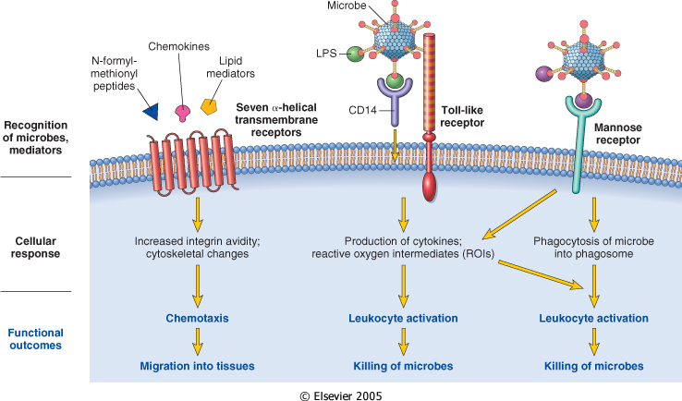
Leukocyte activation. Different classes of cell surface receptors of leukocytes recognize different stimuli. The receptors initiate responses that mediate the functions of the leukocytes.

Slide 13
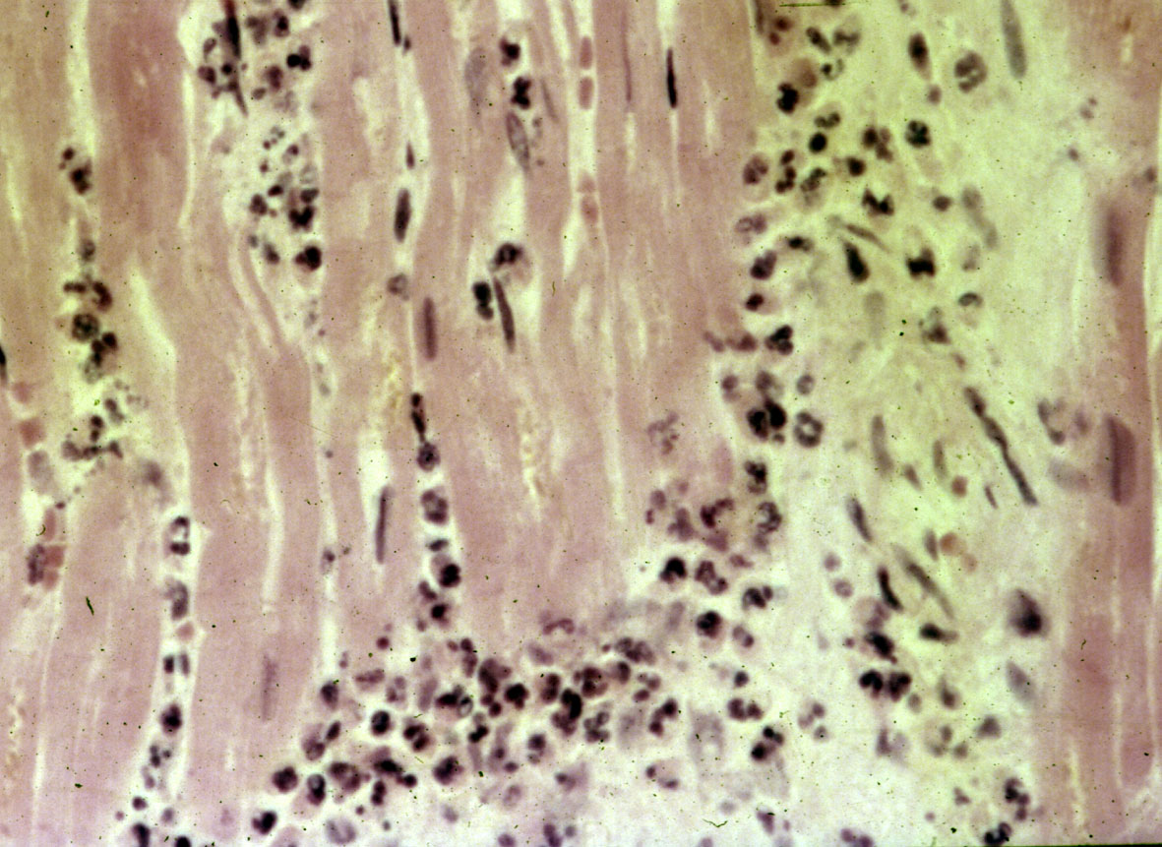
Myocardial infarct - neutrophil infiltration
Dead
myocytes
Neutrophils

Slide 14
Leukocyte-induced tissue injury
Destructive enzymes may enter extracellular space in event of:
Premature degranulation
Frustrated phagocytosis (large, flat)
Membranolytic substances (urate crystals)
Persistent leukocyte activation (RA, emphysema)

Slide 15
Defects of leukocyte function
Genetic defects
Defects of adhesion:
LFA-1 and Mac-1 subunit defects lead to impaired adhesion (LAD-1)
Absence of sialyl-Lewis X, and defect in E- and P-selectin sugar epitopes (LAD-2)
Defects of chemotaxis/phagocytosis:
Microtubule assembly defect leads to impaired locomotion and lysosomal degranulation (Chediak-Higashi Syndrome)

Slide 16
Defects of microbicidal activity:
Deficiency of NADPH oxidase that generates superoxide, therefore no oxygen-dependent killing mechanism (chronic granulomatous disease)

Slide 17
Acquired defects
Defects in chemtaxis-
Malignancy, sepsis, diabetes
Defects in adhesion
Haemodialysis, DM
Decreased phagocytosis and microbicidal activity
Leukaemia, sepsis, DM, malnutrition

Slide 18
Fibrin formation in inflammation
Fibrinogen in the exudates is converted to fibrin
This will form a barrier which localizes the inflammatory reaction

Slide 19
Fibrinous pericarditis

Slide 21
Role of lymphatics in inflammation
The lymphatics are dilated
exudates passes, between endothelial cells into the lymphatics
Some of the lymphatics may be secondarily inflamed (lymphangitis)
The draining lymph nodes may be inflamed

Slide 22
Summary of the acute inflammatory reaction
Transient vasoconstriction
Vasodilation: Increased blood flow
Increased vascular permeability: Exudation
Reduced blood flow and stasis
Diapedesis of RBC
Margination, adhesion and emigration of PNL
Phagocytosis
Formation of fibrin

Slide 23
Chemical mediators
Chemical substances synthesized or released and mediate the changes in inflammation
May be circulating in plasma or
May be produced locally at the site of inflammation by cells.
Most mediators induce their effects by binding to specific receptors on target cells.

Slide 24
Mediators may stimulate target cells to release secondary effector molecules
May act only on one or a few targets or may have widespread activity.

Slide 25
Mediator function is tightly regulated.
Once activated and released from the cell, most mediators
quickly decay (AA metabolites)
are inactivated by enzymes (kininase)
are eliminated or inhibited (antioxidants)
A major reason for the checks and balances is that most mediators have the potential to cause harmful effect

Slide 26
Reactions are similar irrespective of tissue or type of injury
Reactions occur in absence of nervous connections

Slide 27
Chemical mediators of inflammation

Slide 28
Plasma-derived:
Complement, kinins, coagulation factors
Many in “pro-form” requiring activation (enzymatic cleavage)
Cell-derived:
Preformed, sequestered and released (mast cell histamine)
Synthesized as needed (prostaglandin)

Slide 29
Specific mediators
Vasoactive amines
Histamine:
Vasodilation ( principal mediator of immediate phase reaction)
venular endothelial cell contraction,
junctional widening;
Inactivated by histaminase

Slide 30
released by mast cells, basophils, platelets in response to
injury (trauma, heat),
immune reactions (IgE-mast cell FcR),
anaphylatoxins (C3a, C5a fragments),
cytokines (IL-1, IL-8),
neuropeptides,
leukocyte-derived histamine-releasing peptides

