Slide 1
Acute inflammation 5
By Dr. S. Homathy

Slide 2
Basophils & Mast Cells

Slide 3
Mast Cells & Allergy

Slide 4
Specific mediators
Serotonin:
vasodilatory effects similar to those of histamine;
platelet dense-body granules;
release triggered by platelet aggregation

Slide 5
Specific mediators
Plasma proteases
Clotting system
Complement
Kinins

Slide 6
Specific mediators
Arachidonic acid metabolites (eicosanoids)
Prostaglandins and thromboxane:
via cyclooxygenase pathway;
cause vasodilation and prolong edema;
but also protective (gastric mucosa);
COX blocked by aspirin and NSAIDS

Slide 7
Specific mediators
Leukotrienes:
via lipoxygenase pathway;
are
chemotaxins,
vasoconstrictors,
cause increased vascular permeability, and bronchospasm

Slide 8
Specific mediators
PAF (platelet activating factor)
Derived also from cell membrane phospholipid of
Neutrophils, monocytes, basophils, endothelium and platelets.
causes
Vasoconstriction and bronchoconstriction
increased vascular permeability,
increases leukocyte adhesion (integrin conformation)
Leukocyte degranulation
Platelet activation
Release of histamine from platelets
chemotaxis

Slide 9
Specific mediators
Nitric Oxide
short-acting soluble free-radical gas with many functions
Produced by endothelial cells, macrophages, specific neurones in the brain
causes:
Vascular smooth muscle relaxation and vasodilation
Kills microbes in activated macrophages
Counteracts platelet adhesion, aggregation, and degranulation
Uncontroled NO production by activated MP in septic shock can lead to massive peripheral vasodilation and shock

Slide 10
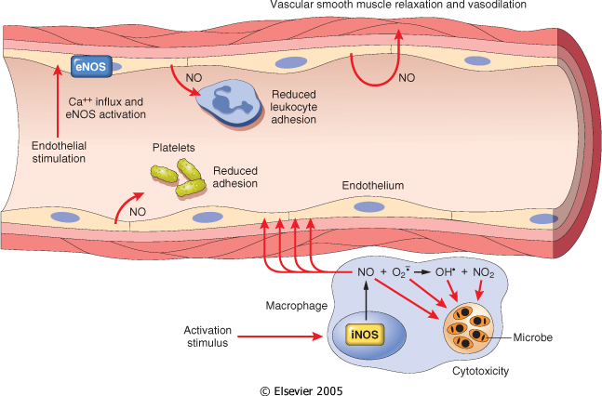

Slide 11
Oxygen derived free radicals
Synthesized via the NADPH oxidase pathway
Released from N and MP after stimulation by
chemotactic agents,
immune cpx,
phagocytic activity

Slide 12
Production of microbicidal reactive oxygen intermediates within phagocytic vesicles.

Slide 13
These include
Superoxide
OH.
H₂O₂
At low concentration amplifying the cascade of inflammatory mediators
At high concentration causes variety of tissue injury mechanism include,
Endothelial cell damage ,increased permeabiity and thrombosis
Inactivation of antiproteases and activation of proteases
Direct injury to the other cell type
Tumour cells, red cells,parenchymal cell

Slide 14
Antioxidant protective mechanism found in tissues and serum
to minimize the toxicity of the oxygen metabolites
Catalase
Superoxide dismutase
Glutathione
Transferin
Ceruloplasmin

Slide 15
Specific mediators
Lysosomal components
Leak from PMNs and macrophages after demise, attempts at phagocytosis, etc.
Acid proteases (only active within lysosomes).
Degrade bacteria and debris within phagolysosomes
Neutral proteases such as
elastase and collagenase are destructive in ECM.
Degade extracellular components
Cleave C3 and C5 directly
Counteracted by serum and ECM anti-proteases (alpha-1 antitripsin inhibits neutrophil elastase
Deficiency of alpha-1 antitripsin lead to
Cationic proteins
Increase vascular permeability
Chemotaxis for monocytes
Inhibition of movement of neutrophils and eosinophils

Slide 17
More specific mediators
Cytokines
They are polypeptide products of many cell types
Products of activated lymphocytes and macrophages
They modulate the function of other cell types
Many non lymphoid cells too produce these
The secretion is transient and tightly regulated
Their effects tend to be pleiotrophic
Different cells are affected differently by the same cytokine
Produced during immune and inflammatory responses

Slide 18
Autocrine effect
They can act on the same cell that produces them
Paracrine effect
Act on other cells in the vicinity
Endocrine effect
Act systemically

Slide 19
Types of Cytokines(CK)
CK that regulate lymphocyte function
Activation, growth and differentiation
Eg: IL-2 stimulate proliferation
TGF-β –inhibit lymphocyte growth
CK involved in innate immunity
TNF and IL-1

Slide 20
3.CK that activate inflammatory cell(MP) during cell- mediated immune response
Interferon-γ (IFN- γ) and IL-12
4.Chemokines
Chemotactic for various leukocytes
5.CK that stimulate haematopoises
Granulocyte – monocyte colony stimulating factor(GM-CSF) and IL-3

Slide 21
IL-1 & Tumor Necrosis Factor (TNF)
Both have additional effects that are important in inflammatory response
Both are produced by activated MP
IL-1 also produced by other cell types.
TNF also causes
aggregation and activation of neutrophils
Release of proteolytic enzymes from mesenchymal cells- contributing to tissue damage

Slide 22
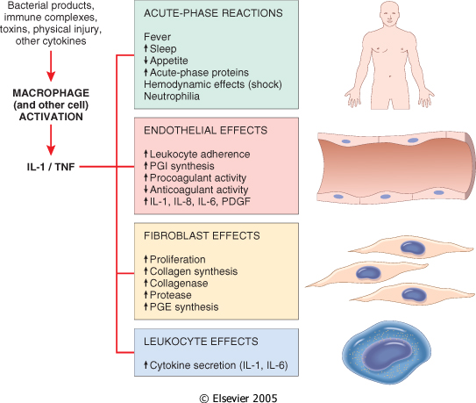
Major effects of interleukin-1 (IL-1) and tumor necrosis factor (TNF) in inflammation

Slide 23
Complement system
Consist of cascade of plasma proteins (C1-C9)
Play an important role in both immunity and inflammation
Has 20 component proteins, together with their cleavage products
Mediate biologic reactions
All of which serve in the defense against microbial agents

Slide 24
Their function in immunity primarily by generating membrane attack complex(MAC)
They effectively punches holes in the membranes of invading microbe
In the process of producing MAC number of complement fragments are produced.
Complement components are present in plasma as inactive form

Slide 25
Most critical step in the elaboration of the biological function of complement is the activation of the 3rd component, C3.
Activation of complement by different pathways leads to cleavage of C3.
C3 cleavage occurs via
Classic pathway- triggered by fixation of C1 to Ag-Ab complex
Alternative pathway- triggered by bacterial polysaccharide

Slide 26
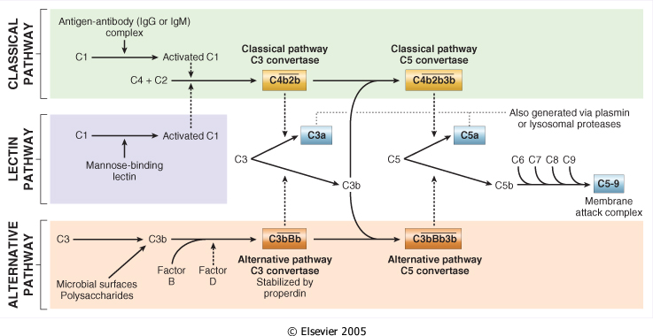
Complement Activation Pathways

Slide 27
The functions of the complement system are mediated by
breakdown products of C3 and
other complement proteins, and
by the membrane attack complex (MAC)

Slide 28
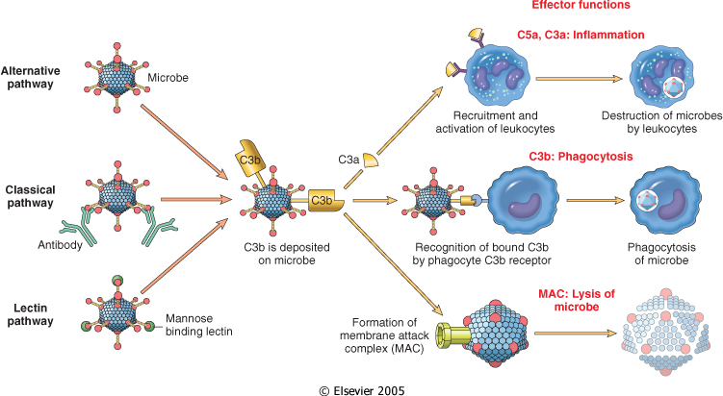

Slide 29
Functions of complement
Vascular effects
C3a and C5a ( anaphylatoxins) –increase vascular permeability and vasodilation by inducing mast cells to release histamine.
C5a
Potent chemotactic agent for N, M, E, B
Activate leukocytes
Increase their adhesion to the vascular endothelium
Activate Arachidonic acid pathway
Phagocytosis
C3b and C3bi act as opsonins

Slide 30
C5-9(MAC)
Membrane lysis of cells
Production of oxygen metabolites
C3 and C5 can be activated by several proteolytic enzymes present in the inflammatory infiltrate
(plasmin, lysosomal enzymes)

Slide 31
Clotting –fibrinolytic system
Interrelationships between the four plasma mediator systems triggered by activation of factor XII (Hageman factor).
Note that thrombin induces inflammation by binding to protease-activated receptors (principally PAR-1) on
platelets,
endothelium,
smooth muscle cells,
other cells.

Slide 32
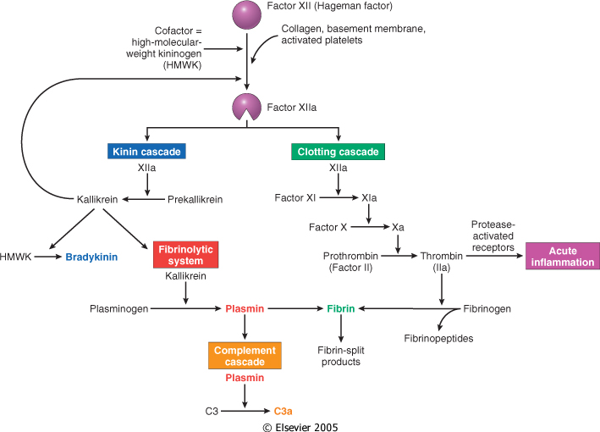

Slide 33
Clotting cascade
Cascade of plasma proteases
Hageman factor (factor XII)
Collagen, basement membrane, activated platelets converts XII to XIIa (active form)
Ultimately converts soluble fibrinogen to insoluble fibrin clot
Factor XIIa simultaneously activates the “brakes” through the fibrinolytic system to prevent continuous clot propagation
Counter regulate clotting by cleaving fibrin
thereby solubilizing the the fibrin clot

Slide 34
Fibrin – insoluble clot
Fibrinopeptide – increased vascular permeability, chemotaxis
Thrombin – leukocyte adhesion, fibroblast proliferation

Slide 35
Kinin system
Leads to formation of bradykinin from cleavage of precursor (HMWK)
Vascular permeability
Arteriolar dilation
Non-vascular smooth muscle contraction (e.g., bronchial smooth muscle)
Causes pain
Rapidly inactivated (kininases)

Slide 36
Fibrinolytic system
Plasminogen is converted into plasmin
Plasmin
lyses fibrin clots
Increase vascular permeability
Activates factor XII- amplify the entire set of response
Cleaves C3 to produceC3 fragments
Degrades fibrin to fibrin split products

Slide 37
Arachidonic Acid Metabolites PG,LT3, Lipoxins
Also called eicosanoids
Derived from the metabolism of AA
Affect variety of biological processes including
Inflammation and haemostasis
They are short range hormones
Act locally at the site of generation
Rapidly spontaneously decay / enzymatically destroyed

Slide 38
AA is a 20-carbon polyunsaturated fatty acid
Derived from dietary linoleic acid and cell membrane phospholipids.
AA released from phospholipids via cellular phospholipases
Which is activated by
mechanical, chemical, physical stimuli
inflammatory mediaters- C5a
Which is inhibited by steroids.

Slide 39
AA metabolism proceed along one of the two pathway
Cyclooxygenase pathway- Synthesizing
prostaglandins and thromboxanes
Lipoxygenase pathway- Synthesizing
Leukotrienes and lipoxins
They can mediate virtually every step of inflammation

Slide 40
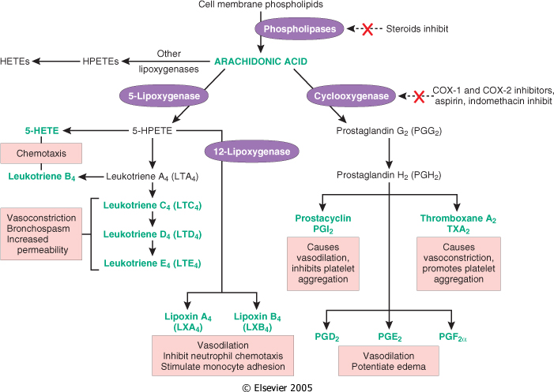

Slide 41
Generation of arachidonic acid metabolites and their roles in inflammation.
The molecular targets of some anti-inflammatory drugs are indicated by a red X.
COX, cyclooxygenase; HETE, hydroxyeicosatetraenoic acid;
HPETE, hydroperoxyeicosatetraenoic acid.

Slide 42
Prostaglandins
Major metabolite of the COX pathway in mast cell.
Regarded as autocoid -Rapidly spontaneously decay / enzymatically destroyed
Act locally at the site of generation
Also cause pain and fever
Can pass from one cell to another

Slide 43
Cyclooxygenase pathway
There are two forms of cyclooxygenase
COX-1
COX-2
COX-1 is found in the gastric mucosa
Mucosal PGs produced by COX -1 are protective against acid induced damage
Inhibition of COX by Aspirin and NSAIDs predispose to gastric ulceration
To prevent this, highly selective COX-2 inhibitors are now available(COX-2 not expressed in the gastric mucosa

Slide 44
Role of Mediators in Different Reactions of inflammation

Slide 45
Vasodilatation | Prostaglandins Nitric oxide Histamine
Increased vascular permeability | Vasoactive amines C3a and C5a (through liberating amines) Bradykinin Leukotrienes C4, D4, E4 PAF Substance P
Chemotaxis, leukocyte recruitment and activation | C5a Leukotriene B4 Chemokines IL-1, TNF Bacterial products
Fever | IL-1, TNF Prostaglandins
Pain | Prostaglandins Bradykinin
Tissue damage | Neutrophil and macrophage lysosomal enzymes Oxygen metabolites Nitric oxide

Slide 46
Systemic effects of acute inflammation
Fever
‘Endogenous pyrogens’ produced:
IL1 and TNFa
IL-1 act on vascular receptors in the thermoregulatory center of the hypothalamus
Leads to production of prostaglandins in hypothalamus(hence aspirin etc. reduce fever)
PGE act on the vasomotor center
Resulting in sympathetic nerve stimulation
Vasoconstriction of skin vessels
Causes reduced heat dissipation and fever.

Slide 47
Leukocytosis
IL1 and TNFa produce an accelerated release of cells from bone marrow
Rise in number of more immature Nin the blood(“shift to the left’)
Macrophages, T lymphocytes produce
Colony-Stimulating Factors
Causes proliferation of precursors in bone marrow
Clinically useful
Bacterial infections - neutrophilia
viral - lymphocytosis
Parasitic infestation- eosinophilia
Typhoid and viral infections- leucopenia

Slide 48
Acute phase response
Decreased appetite,
altered sleep patterns
Hypotension
Increased degradation of proteins
changes in plasma concentrations of acute phase proteins
Acute phase proteins:
C-reactive protein (CRP) (Clinically useful)
α₁ antitrypsin
Haptoglobin
Fibrinogen
Serum amyloid A protein
Complement
Coagulation protein
Most of these are mediated by IL-1, IL-6 and TNF

Slide 49
Problems caused by acute inflammation
Local
Swelling:
Blockage of tubes, e.g. bile duct, intestine
Exudate:
Compression e.g. cardiac tamponade
Loss of fluid e.g. burns
Pain & loss of function - especially if prolonged
‘Bystander effect’ exacerbates damage, may initiate autoimmunity

Slide 50
Systemic
Acute phase response
Spread of micro-organisms and toxins
SHOCK

Slide 51
Laboratory manifestations
Leukocytosis
(granulocytosis vs. lymphocytosis)
Elevated serum acute phase proteins
(C-reactive protein, fibrinogen, etc)
Increased ESR
(erythrocyte sedimentation rate)
Hypercoagulability

Slide 52
Diagnosis of acute inflammation
Cardinal features of inflammation
Fever
Laboratory evidence
ESR
CRP, fibrinogen, haptoglobulin
Increased WBC- neutrophils with toxic granules, left shift
Examination of inflammatory exudate
Biopsy
Test for specific aetiology
Serum antibody, complement
Culture, grame stained smear

Slide 53
Outcome of acute inflammtion
Complete resolution
Little tissue damage
Capable of regeneration
Scarring (fibrosis)
In tissues unable to regenerate
Excessive fibrin deposition organized into fibrous tissue

Slide 54
3. Abscess formation occurs with some bacterial or fungal infections
4. Progression to chronic inflammation (next

